Slide 1
Statistics workshop
Shi Min CHUA
11 December 2024
shiminc@gmail.com

Slide 2

Have you recently done/been planning to any quantitative analysis ?
What are you measuring?
What is your hypothesis?
What statistical analysis have you done?
Any difficulties?

Slide 3
Overview
Types of Variable
Likert-scale vs Likert-type item
Data analysis
General procedure
Descriptive statistics
Excel (pivot table/chart)
Inferential statistics
JASP/SPSS

Slide 4

Type of Variables

Slide 5

Research Design
Independent Variable
Predictor/Factor
Experimental conditions (‘Manipulated’)
Dependent Variable
Outcome measure
This study seeks to determine whether there are ethnic differences in the pitch contours of Singlish discourse particles produced by Singlish speakers.

Slide 6
Data
Discrete
(Categorical)
Nominal
Ordinal
Interval
Ratio
Continuous
(Scale)
Variables
(Data)
Notes:
Continuous data can take any value in a specified range and the possibilities are infinite because there are no gaps in the continuum
Discrete data can only take a finite number of distinct values

Slide 7
Nominal
no meaningful order between the data
e.g., gender, race, language spoken
Religion | Frequency/Count
No religion | 250
Christian | 141
Buddhist | 19
Hindu | 26
Jewish | 11
Muslim | 49
Sikh | 3
Others | 7
What is your religion?
  No religion
  Christian
  Buddhist
  Hindu
  Jewish
  Muslim
  Sikh
  Others

Slide 8
Frequency/count
Ethnicity

Slide 9
Nominal
Sometimes, researchers code/categorise data into nominal data.
E.g., What is your age?
Age Group | Frequency/Count
Aged 15 years and under | 103
Aged 16 to 64 years | 204
Aged 65 years and over | 199

Slide 10
Cross-tabulation of two/more nominal variables
Religion | Aged 15 years and under | Aged 16 to 64 years | Aged 65 years and over | Marginal Sum
No religion | 76 | 107 | 67 | 250
Christian | 10 | 56 | 75 | 141
Buddhist | 0 | 4 | 15 | 19
Hindu | 5 | 10 | 11 | 26
Jewish | 1 | 4 | 6 | 11
Muslim | 11 | 20 | 18 | 49
Sikh | 0 | 1 | 2 | 3
Others | 0 | 2 | 5 | 7
Marginal Sum | 103 | 204 | 199 | 506
Chi-square (χ2) test for independence to examine if a relationship exists between two or more categorical variables

Slide 11
Ordinal
There is a meaningful order/ranking
But the differences between the ordered categories are not quantifiable/known/equal.
Severity of a disease
Mild
Moderate
Severe
How is your proficiency in reading Language X
1 = Poor
2
3
4 = Average
5
6
7 = Very good
How often do you seek assistance from customer support?
Very frequently
Occasionally
Rarely
Never

Slide 12
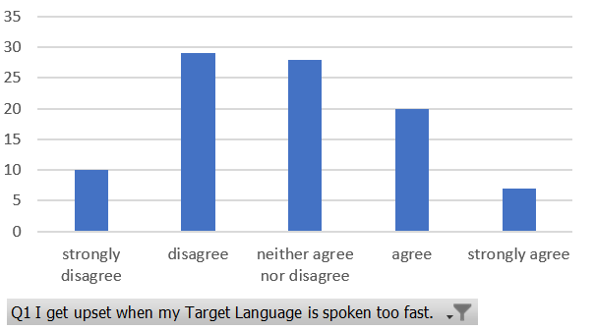
Ordinal
Depending on data distribution, you might regroup/categorise the data into nominal
I get upset when my Target Language is spoken too fast.
Strongly Disagree | 12
Disagree | 7
Neutral | 19
Agree | 3
Strongly Agree | 11
I get upset when my Target Language is spoken too fast.
Disagree | 19
Neutral | 19
Agree | 14

Slide 13
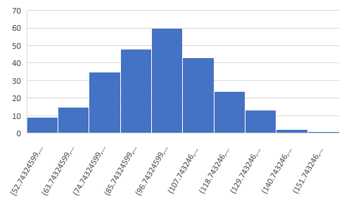
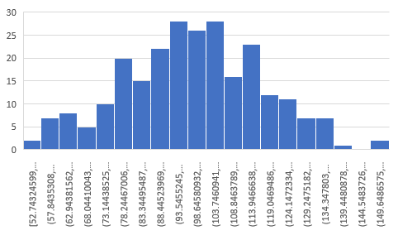
Interval/Ratio - Scale
Meaningful interval between data points
Interval data does not have a meaningful zero, e.g., temperature
Ratio does have a meaningful zero, e.g., time used to articulate a word presented on screen, scores on a test or scale
Frequency/count
Frequency/count
Scores
Scores

Slide 14
Score B
Score A

Slide 15
Type of Variables/Data
Data
Discrete
(Categorical)
Nominal
Ordinal
Continuous
(Scale)
Interval
Ratio
No meaningful order
Meaningful order
But no meaningful interval
Meaningful order, interval,
But no meaningful zero
Meaningful order, interval, zero

Slide 16
Likert-Scale vs Likert-type Item

Slide 17
Likert-type item
Do you agree …
1 = Strongly disagree
2 = Disagree
3 = Neutral
4 = Agree
5 = Strongly agree
How is your proficiency in reading XX language
1 = Poor
2
3
4 = Average
5
6
7 = Very good

Slide 18
Likert Scale
The Likert scale refers to the set of at least three items aggregated (summed or averaged) together to represent a single attribute being measured.
The outcome variable to be analysed is the Composite Scores, e.g., average or sum
Typically requires establishing validity and reliability
Multiple components, e.g., motivation, necessity, engagement and agency
Although each item is in ordinal scale, Likert-Scale data is sometimes analysed as interval data, mainly because the composite scores turn the data into a scale because of the averaging/summing. However, it depends on the data distribution.

Slide 19

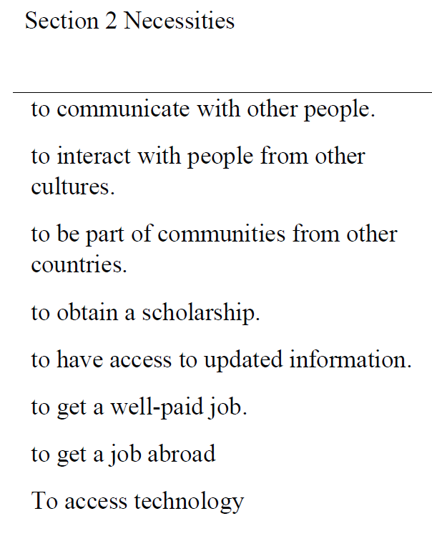
Likert-Scale
1 = totally disagree
2 = partially disagree
3 = partially agree
4 = totally agree
Dauzón-Ledesma, L., & Izquierdo, J. (2023). Language Learning Investment in Higher Education: Validation and Implementation of a Likert-Scale Questionnaire in the Context of Compulsory EFL Learning. Education Sciences, 13(4), 370. https://doi.org/10.3390/educsci13040370

Slide 20
Am I analysing Likert-type item or Likert-Scale?
Do you analyse the item individually or in a set or as a whole?

Slide 21
Data analysis
Likert-type item

Slide 22
General procedure
Data cleaning and structuring
missing data
coding of data (computers like number)
top row as variable name
first column as index/participant ID
one row corresponds to one data point (one participant)
one column corresponds to one variable
All data to be visualised in the same sheet
Descriptive Analysis + visualisation - exploratory
Inferential Analysis – hypothesis testing to draw conclusion about the general population

Slide 23
Descriptive Analysis
Likert-type Item
Mode: The most frequent responses
Median: The middle number
Distribution of responses
Likert Scale
Mean
Standard deviation (SD)
Why don’t we use mean for likert-type item?
Notes:
s. For example, what does the average of ‘‘never’’
and ‘‘rarely’’ really mean? Does ‘‘rarely and a half’’ have a
useful meaning?3 Furthermore, if responses are clustered at
the high and low extremes, the mean may appear to be the
neutral or middle response, but this may not fairly
characterize the data.

Slide 24
Descriptive Analysis
Likert-type Item
Mode: The most frequent responses
Median: The middle number
Distribution of responses
Likert Scale
Mean
Standard deviation (SD)
Why don’t we use mean for likert-type item?
Mean = 2.84
Notes:
s. For example, what does the average of ‘‘never’’
and ‘‘rarely’’ really mean? Does ‘‘rarely and a half’’ have a
useful meaning?3 Furthermore, if responses are clustered at
the high and low extremes, the mean may appear to be the
neutral or middle response, but this may not fairly
characterize the data.

Slide 25
Demonstrations
Excel
Pivot table/chart
Recode
Descriptive analysis

Slide 26
Inferential statistics
Based on our sample, what we could say about population
Hypothesis testing
  Null hypothesis – No difference between groups, No difference before and after intervention
  H1/Alternative hypothesis – There is a difference between groups, before and after
p-value < 0.05 (or sometimes 0.001, depending on the field) indicates that there is a significant difference/effect, while p<0.1 marginally significant (depending on the field)

Slide 27
What statistical analysis to be conducted?
Research design:
Between-subject
Within-subject/paired sample
  Pre- vs. Post- Intervention
  Condition A vs. Condition B

Slide 28
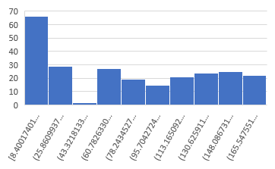
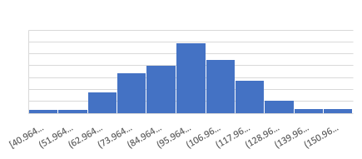
What statistical analysis to be conducted?
Types of data/data distribution of dependent variable(outcome measure)
  Parametric vs. nonparametric
  Continuous vs. discrete
Frequency/count
Frequency/count
Notes:
Nonparametric tests can be used for categorical data or continuous data that is not normally distributed.

Slide 29
Non-parametric statistical analysis
Between-subjects:
Wilcoxon rank-sum test/ Mann–Whitney U test
Within-subjects:
Wilcoxon sign-rank

Slide 30
Comparing 2 groups on their response on one Likert-type item
Q1 I get upset when my Target Language is spoken too fast.
94 participants in group A, 47 in group B
Independent variable:
Dependent variable:
Between-subjects or Within-subjects?
Parametric or non-parametric?

Slide 31
Comparing 2 groups on their response on one Likert-type item
Q1 I get upset when my Target Language is spoken too fast.
94 participants in group A, 47 in group B
Independent variable (what we ‘manipulate’): group (categorical data)
Dependent variable (what we measure): the responses (ordinal data)
Between-subjects
Nonparametric

Slide 32
Wilcoxon rank-sum test/ Mann–Whitney U test
Null hypothesis:
there’s no difference between the groups such that a similar number of high and low ranks in each group
Alternative hypothesis:
One group has a greater number of high ranks than the other.
Low
High

Slide 33
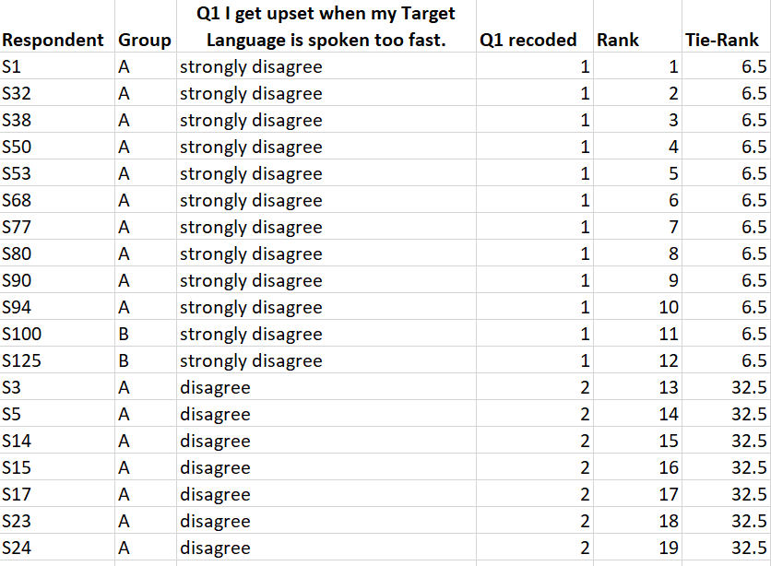
Rank
Sum Rank
Mean Rank
(1+2+3+4+5+6+7+8+9+10+11+12)/12
= 6.5

Slide 34
Data file for JASP
.csv (comma separated values)
.sav (IBM SPSS data file)
.txt (plain text)
.tsv (tab-separated values)
.ods (Open Document spreadsheet)
Important
When you save your Excel file into a csv, all the formatting/function are gone, and only the sheet you are on when saving is done. CSV does not have multiple sheets.

Slide 35
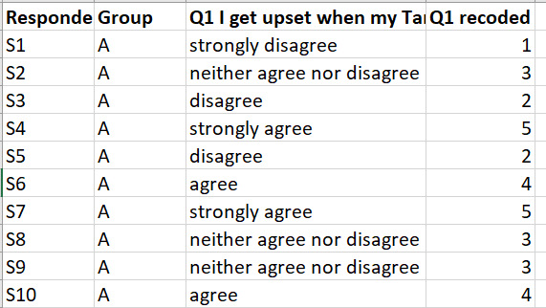
Data format for Mann-Whitney U test in JASP
Each participant in one row
One column indicates the group the participant is in
One column for the dependent variable/outcome measure

Slide 36
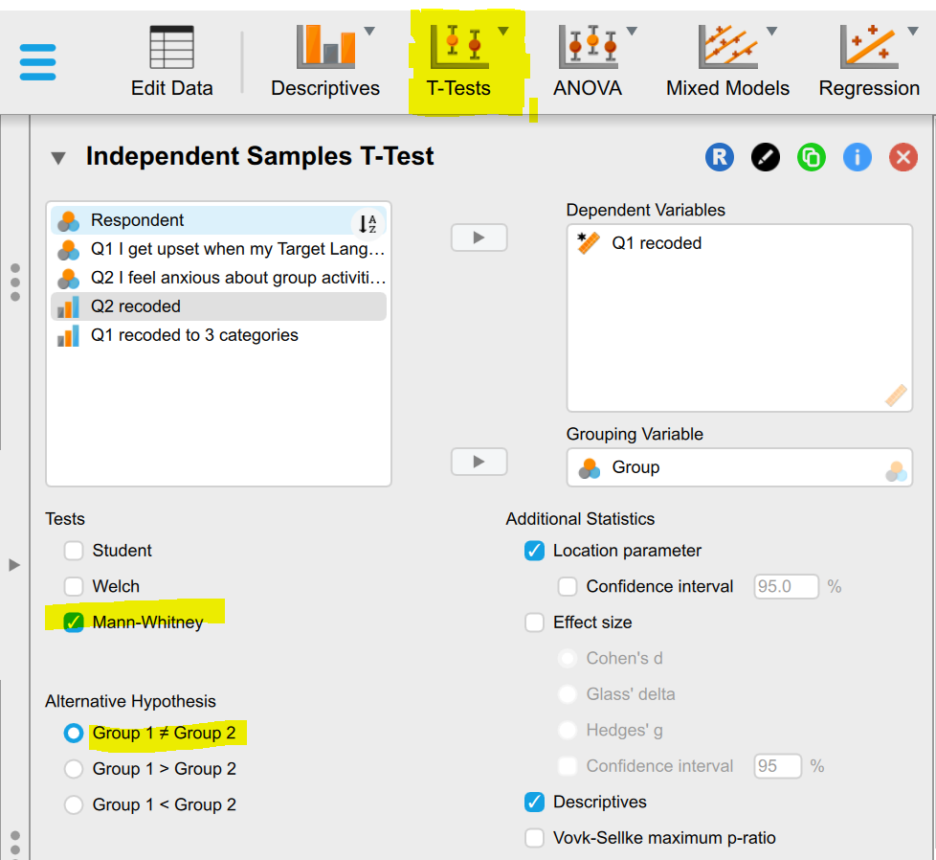
Demonstration on JASP
(Settings)

Slide 37
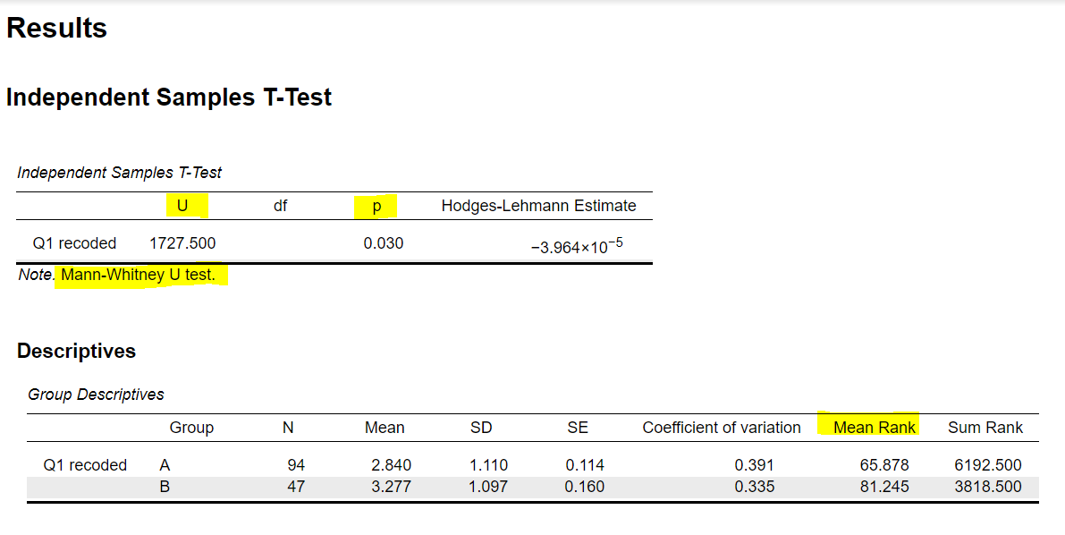
Demonstration on JASP
(Results)

Slide 38
Reporting the results
A Mann-Whitney U test shows a significant difference between group A (median = X) and B (median = X) in their rating of Q1, U =1727.500, p = 0.030, with more participants in group B rate toward agree and strongly agree.

Slide 39
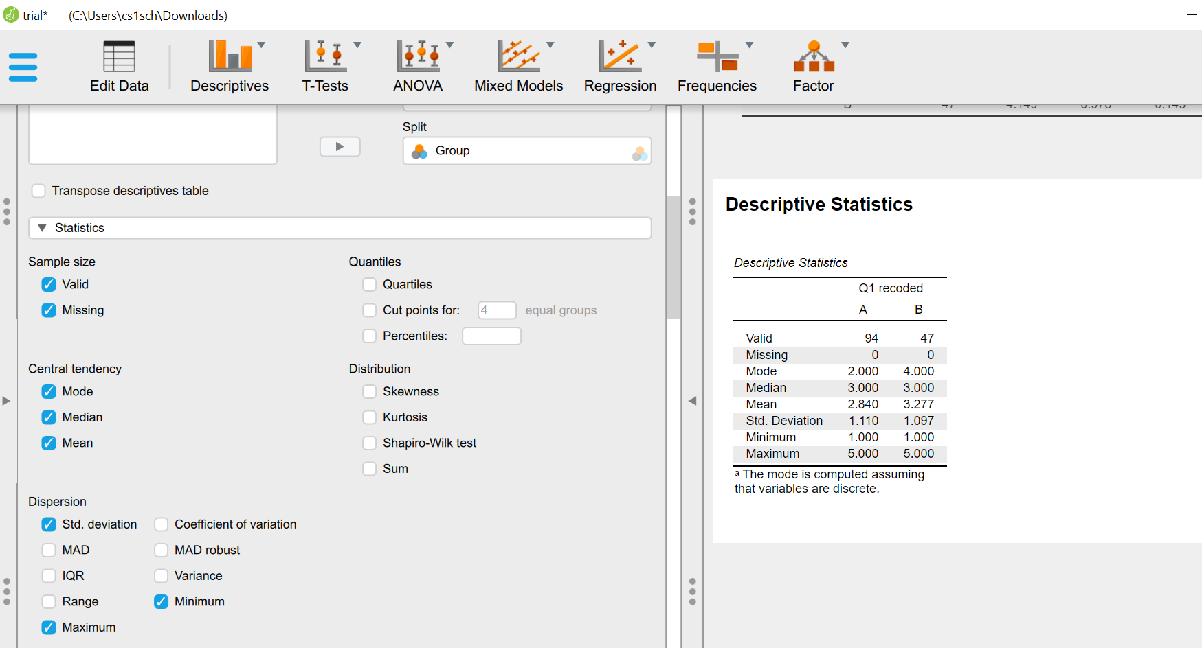
Descriptive Statistics in JASP

Slide 40
Practice + Break
Try replicate the analysis of Q1
Q2 I feel anxious about group activities
  Recode in the software
  Then run the analysis

Slide 41
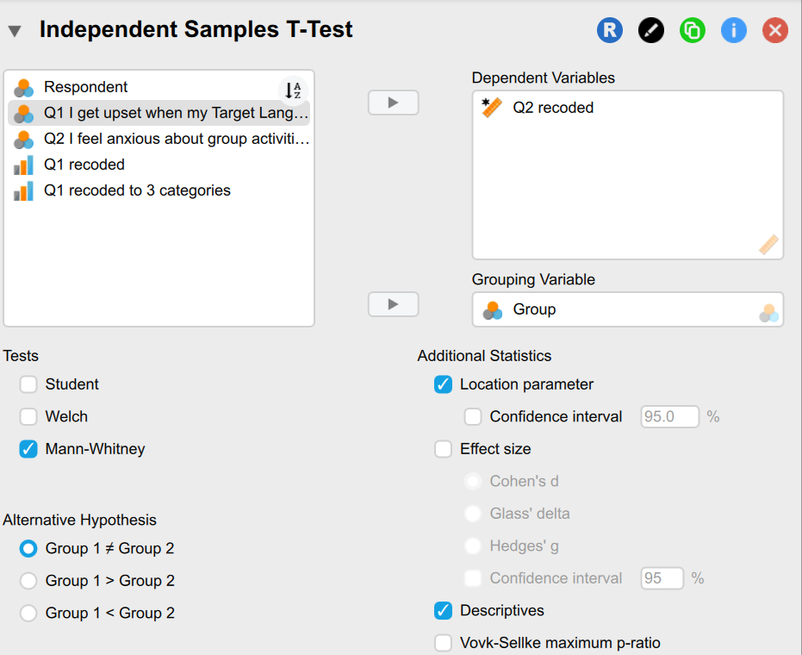
Solutions

Slide 42
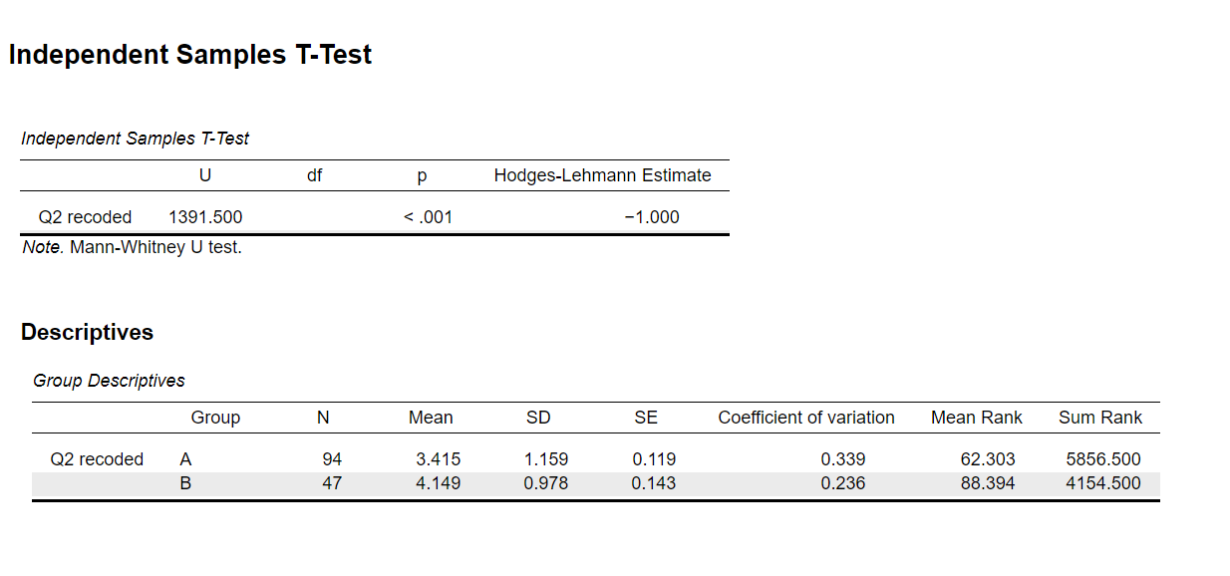
Results

Slide 43
Comparing participants’ response on one Likert-type item before and after
Q1 My overall speaking ability in TL is…
62 participants went through some learning
Asked to rate this question before and after
Independent variable (what we ‘manipulate’):
Dependent variable (what we measure):
Between-subjects or Within-subjects?
Nonparametric or parametric?

Slide 44
Comparing participants’ response on one Likert-type item before and after
Q1 My overall speaking ability in TL is…
62 participants went through some learning
Asked to rate this question before and after
Independent variable (what we ‘manipulate’): Condition (categorical data)
Dependent variable (what we measure): the responses (ordinal data)
Within-subjects
Non-parametric

Slide 45
Wilcoxon sign-rank
Null hypothesis:
There is no difference between the pre- and post- rating by individual, i.e., 0 difference.
Alternative hypothesis:
There is a change/improvement/reduction from pre to post rating
Differences between scores/rank of the same subject in the two conditions

Slide 46
Wilcoxon sign-rank
We compare the number of cases where the post score is greater that the pre score than the number of cases where the pre score is greater than the post score
Find the difference (record positive/negative sign), then rank based on absolute value
Sum the positive rank, negative rank

Slide 47
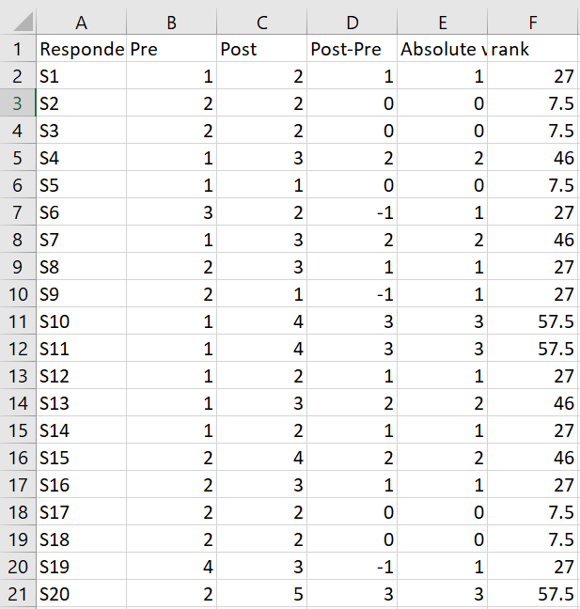
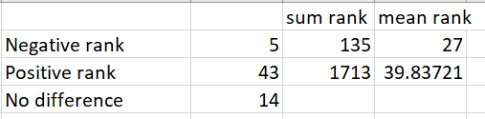
Rank
Sum Rank
Mean Rank

Slide 48
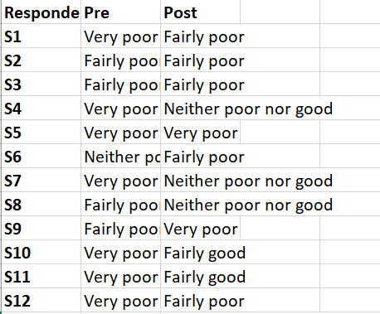
Data format for Wilcoxon sign-rank test in JASP
Each participant in one row
Pre-test/Condition A score in one column
Post-test/Condition B score in another column

Slide 49
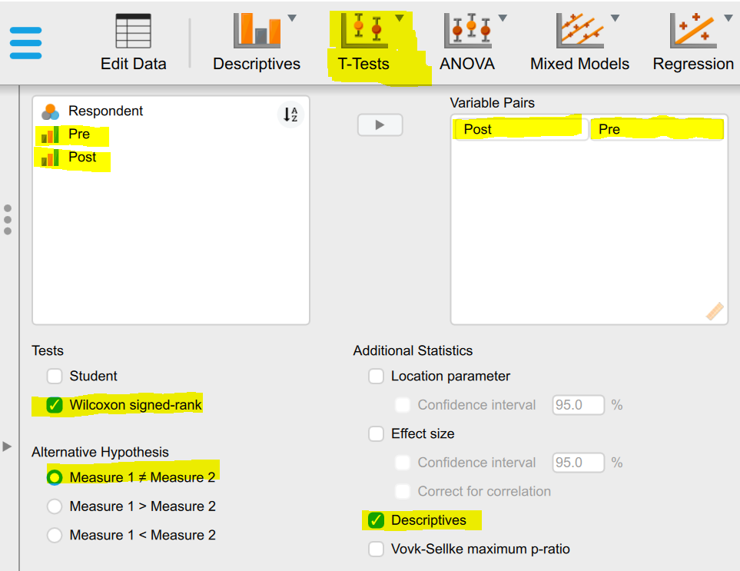
Demonstration on JASP
(Settings)

Slide 50
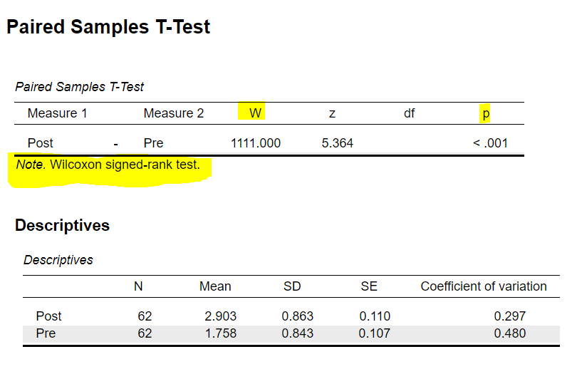
Demonstration on JASP
(Results)

Slide 51
Reporting results
A Wilcoxon signed rank test showed that there was a significant difference (W = 1111.000, z = 5.346, p<0.001) between post intervention score (median = X) and pre intervention score (median = X) with more participants indicating more favouriably about their speaking ability in L after the intervention.

Slide 52
Recap
Type of data Categorical vs. Continuous data
01
Likert-type item – Ordinal data
02
Between subject – Mann-Whitney U test
03
Within subject – Wilcoxon Sign Rank test
04

